Slide 1

FARM SERVICE AGENCY
(FSA)

Slide 2
Brian Gossling
Farm Loan Program Director
Farm Service Agency
Phone: (515) 331-8450
brian.gossling@usda.gov

Slide 3

FSA’s Farm Loan Programs

Slide 4
Iowa FSA Loan Teams
Loan teams in 34 county offices
Cover all counties in the state
Contact your local FSA office or loan team for assistance
FSA Office Locator:
https://www.farmers.gov/service-center-locator?utm_medium=email&utm_source=govdelivery

Slide 5
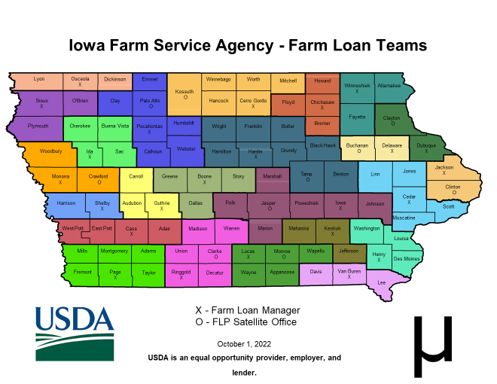

Slide 6
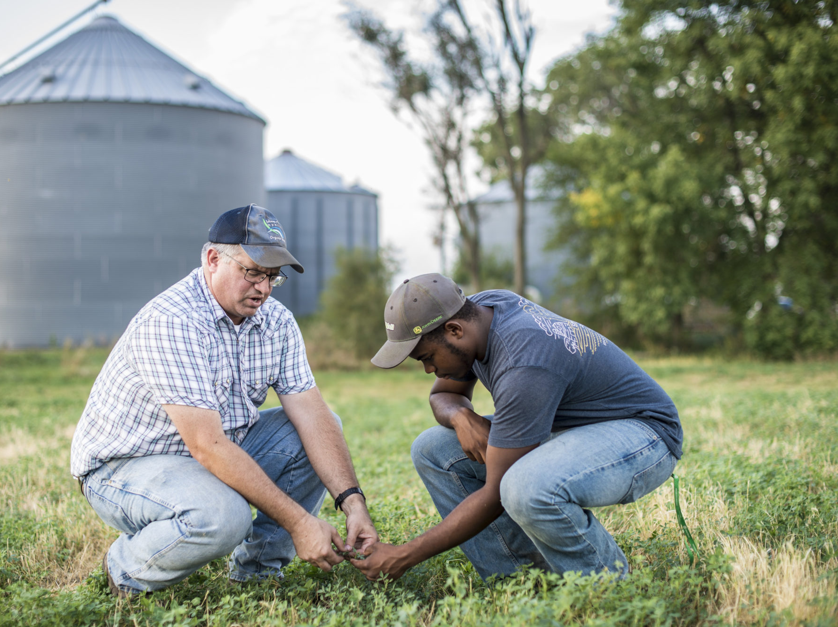
What is a Beginning Farmer?
Operating Loans:
- operated a farm or ranch for not more than 10 years

Slide 7
Beginning Farmer - Farm Ownership LOANS:
Does not own real estate acres exceeding 30% of the averaged-sized farm in the county where the farm is being purchased
3 years of experience
-farm management (minimum of 1 year)
-ag education
-military experience
-mentorship
-business management

Slide 8
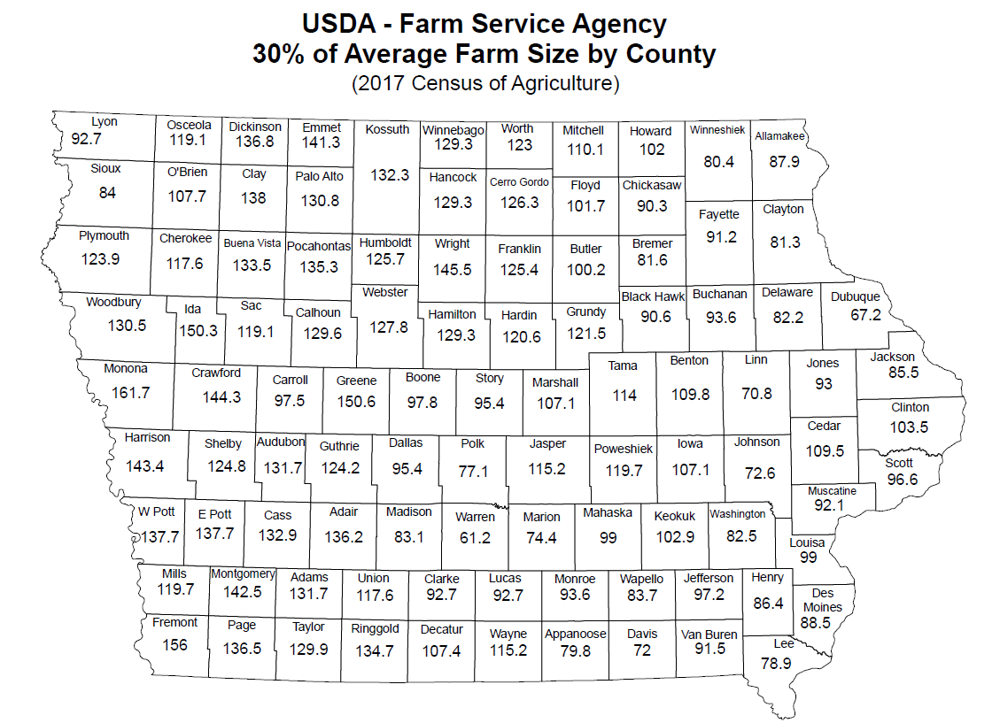

Slide 9

Direct Loan Programs

Slide 10

Types of Direct Loans
Farm Operating
Farm Ownership
Emergency
Microloans

Slide 11
Direct Loan Program
Eligible farmer applies and obtains a loan directly from FSA
Rates and terms based on FSA guidelines
Payments are made to FSA
FSA documents
Supplement to commercial lending programs, not a replacement.

Slide 12
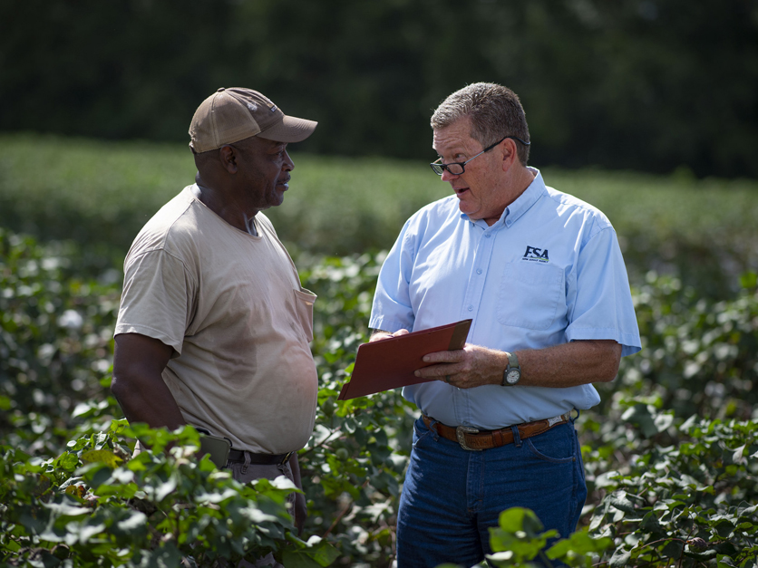
Direct Operating Loans
Interest rate
5.125% (Dec 2022)
Repayment terms
1-7 years
Loan limit
$400,000

Slide 13
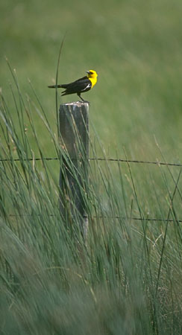
Farm Ownership Loan Programs
Down Payment
  Available for beginning and underserved farmers
Participation Loan
Regular Farm Ownership

Slide 14
Down Payment Farm Ownership Loan Program
5% down payment (minimum)
FSA loan - 45% of purchase price up to a $300,150 maximum loan amount
Balance of the financing must come from another source (Bank, FCS, contract, etc.)
FSA interest rate – 1.5% (Dec 2022)
Repayment: FSA – 20 years
Other – 30 years
Funds for purchases only

Slide 15
Participation Farm Ownership Loan Program
FSA’s loan is limited to 50% of the financing
Balance of the financing must come from another source (Bank, Farm Credit Services, contract, etc.)
Interest rate –
3% (Dec 2022)
Repayment terms – 30 to 40 years based on cash flow
FSA loan maximum - $600,000 (no maximum purchase price)
FSA can take a second lien on the property being purchased

Slide 16
Regular Farm Ownership Loan Program
FSA can provide up to 100% of the financing
Interest rate – 5% (Dec 2022)
Repayment terms - 30 to 40 years based on cash flow
FSA loan maximum - $600,000 (no maximum purchase price)
FSA can take a second lien on the property being purchased

Slide 17

Guaranteed Loan Programs

Slide 18
Guaranteed Loan Programs
Financing through a traditional non-government source (Bank, Farm Credit Services, etc.)
FSA backing – up to 90-95%

Slide 19

Guaranteed Loan – Benefits
Higher maximum loan amount
  $2.037 million in loans per operation
Increased flexibility for the lender
  Loan limits
  Other borrowing
Secondary market options to allow the producer additional pricing and repayment options

Slide 20
Guaranteed Loan Philosophy
Encourage loans at competitive rates and terms
Lender’s loan and relationship
Lender forms – note/mortgage/etc.
Shared expertise to protect the lender and the government

Slide 21
Types of Guaranteed Loans
Term Operating (G-OL)
Annual Operating Line of Credit (G-LOC)
Farm Ownership (G-FO)
Conservation (G-CL)

Slide 22
FSA Financing of livestock facilities – Environmental Compliance
Location
  Consider proximity to neighbors, towns, lakes, rivers, streams and other sensitive areas
Preliminary Public Notice
  Published weekly for 2 consecutive weeks or daily for 3 days
  30-day public comment period from when notice ends
  Alternative: Letter to neighbors within a 1.5 mile radius of the site
Archeological Assessment
  Paid by applicant
  State Historical Preservation Office review
  Tribal Historical Preservation Office review

Slide 23
Important environmental reminders for FSA financing
Do not start dirt work or disturb the soil prior to completion of the archeological assessment and Agency approval
Plan ahead as the review takes time (think months not weeks)
An archeological assessment cannot be completed when the ground is frozen
Consider sites that avoid issues with neighbors, towns and sensitive areas (lakes, streams, etc.)
Seek advice and counsel early and often

Slide 24
FSA Loan Information On The Web:
FSA Web page: https://www.fsa.usda.gov/
Direct link to FSA’s Farm Loan Programs:
http://www.fsa.usda.gov/dafl
“Your Guide to FSA Loan Programs” is a good place to start.
USDA Programs: https://www.farmers.gov/
New Farmer Site:
https://newfarmers.usda.gov

Slide 25
Questions?

